Slide 1
NETWORKING CONCEPTS
Integrated Services Digital Network (ISDN) and Asynchronous Transfer Mode (ATM)

Slide 2
Network Convergence
There have been separate Voice network (PSTN) and Data Networks (Frame Relay, SMDS, etc.)
PSTN is sometimes used as a data network backbone, but PSTN is circuit switched (voice-optimized) and PSTN based WAN not efficient
Delay sensitive traffic such as voice not possible on data networks since no guarantee of QoS
Initial attempts to converge data and voice was network not too successful hence ISDN
ATM was developed in early 80’s as a switching technology for a new Broadband ISDN (B-ISDN) network.

Slide 3
Integrated Services Digital Network (ISDN)
First offered in the late 1970s, acceptance slowed due to a lack of standardization and relatively high costs.
International standard for transmitting data over digital lines established by the ITU
Narrowband ISDN, combines voice, video, and data over the same digital circuit.
ISDN provides digital dial-up lines that work much like analog lines.
  Since the line is digital, an “ISDN modem” which sends digital transmissions is used.
All ISDN connections are based on two types of channels:
  The B channel is the “bearer” channel
  The D channel is the “delta” channel

Slide 4
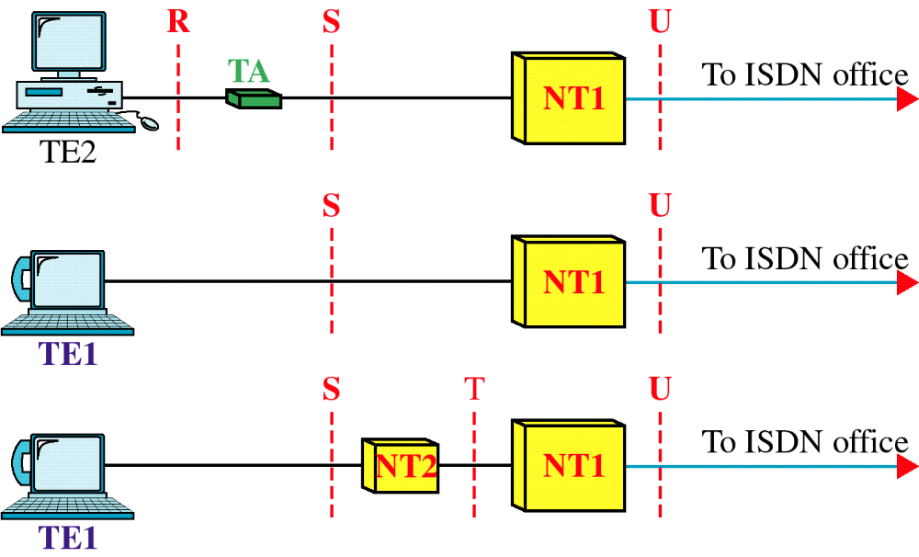
ISDN Reference Configuration

Slide 5
ISDN Reference configuration
TE1 (Terminal Equipment type 1): ISDN capable device.
TE2 (Terminal Equipment type 2): Other communications equipment that are not ISDN able.
TA (Terminal Adapter): Lets the TE2 talk to the ISDN network.
  Also adapts other kinds of equipment e.g. Ethernet interfaces to ISDN.
NT1 (Network Termination type 1): The end of the line for the local phone company and the beginning of the houses phone network
  Converts a 2-wire U interfaces into a 4 wire S/T interface.
  Supports multiple devices

Slide 6
ISDN Reference configuration
NT2 (Network Termination type 2): Used in big institutions with a private telephone system.
  It converts a t interface into the S interface.
LT (Line Termination): The physical connection to the phone company.
ET (Exchange Termination): Connection to other switches within the phone network.
R, S, T, U, and V: They are reference points.
  What goes along different reference points is different, i.e. different wiring requirements, different data speeds, different encoding etc.

Slide 7
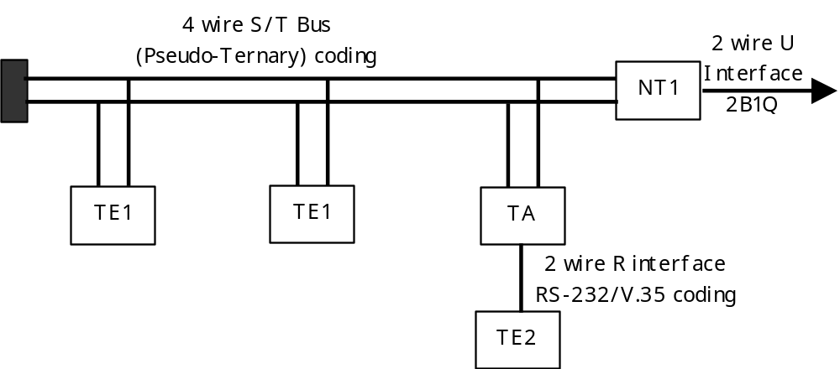
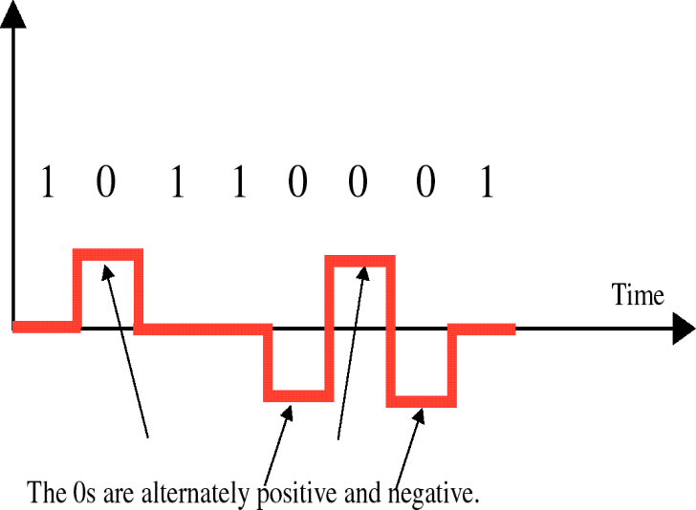
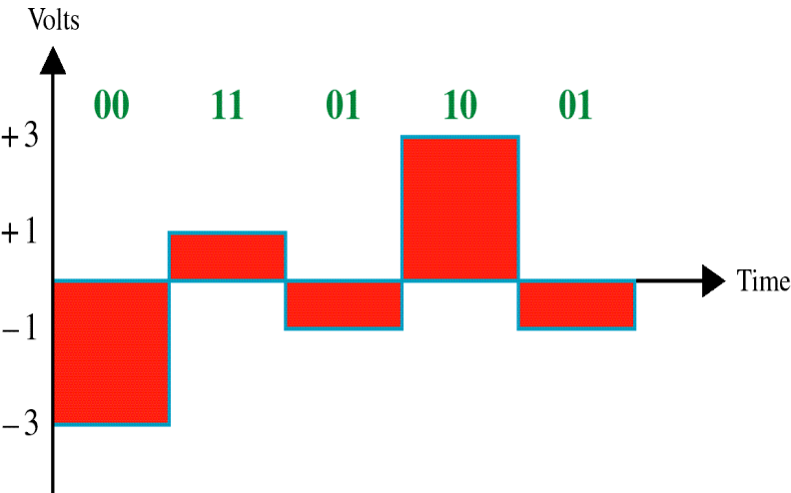
ISDN Signaling interfaces
Pseudoternary
2B1Q

Slide 8
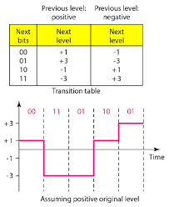
Multilevel 2B1Q scheme

Slide 9
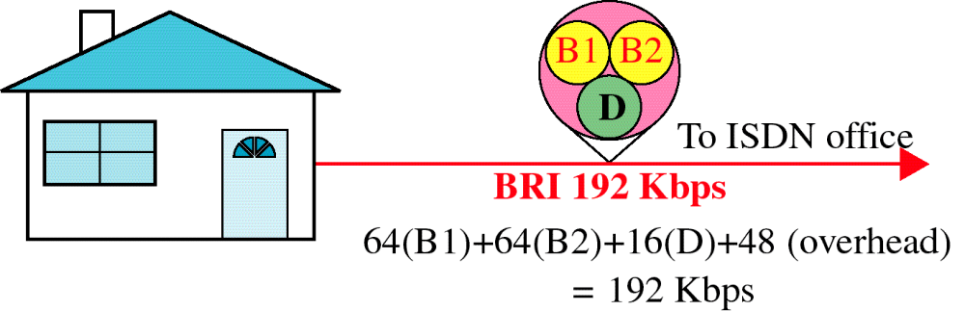
BRI (Basic Rate Interface)
The Network Termination 1 (NT1) device connects twisted-pair wiring at customer’s building with ISDN terminal equipment (TE) via RJ-11 or RJ-45 data jacks
A terminal adapter (TA) converts digital signals into analog signals for use with ISDN phones and other analog devices

Slide 10
Basic ISDN Interface (1)
Digital data exchanged between subscriber and NTE - Full Duplex
Separate physical line for each direction
Pseudoternary coding scheme
  1=no voltage, 0=positive or negative 750mV +/-10%
Data rate 192kbps
Basic access is two 64kbps B channels and one 16kbps D channel (2B + D)
  This gives 144kbps multiplexed over 192kbps
Remaining capacity used for framing and sync

Slide 11
Basic ISDN Interface (2)
B channel is basic user channel
  Data
  PCM voice
Separate logical 64kbps connections for different destinations
D channel used for control or data
  LAPD frames
Each frame 48 bits long
One frame every 250μs

Slide 12
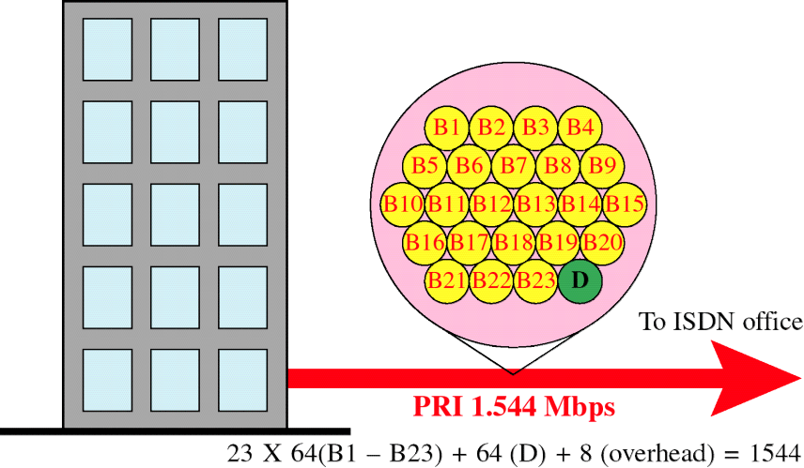
PRI (Primary Rate Interface)
Point to point
Typically supporting PBX
1.544Mbps
  Based on US DS-1
  Used on T1 services
  23 B channels plus one D channel (23B + D)
  Line coding is AMI using B8ZS
2.048Mbps
  Based on European standards
  30 B channels plus one D channel (30B + D)
  Line coding is AMI using HDB3

Slide 13
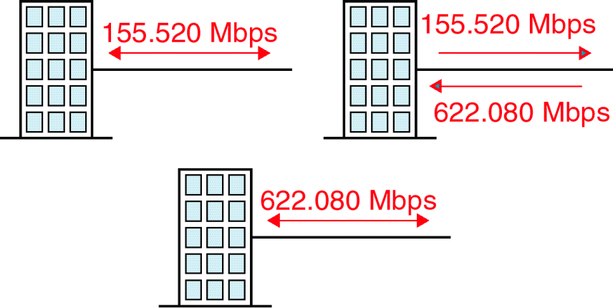
Broadband ISDN
Broadband ISDN (B-ISDN) is a circuit-switched service that uses ATM to move data.
B-ISDN is backwardly compatible with ISDN.
Three B-ISDN services are currently offered:
  Full duplex channel at 155.2 Mbps
  Full duplex channel at 622.08 Mbps
  Asymmetrical service with two simplex channels (Upstream: 155.2 Mbps, downstream: 622.08 Mbps)

Slide 14
ATM Overview
Proposed telecommunication standard for Broadband ISDN
Cell switched, connection-oriented networking technology
Uses short, fixed length packets called cells
  Provides dedicated, high-speed connections to a virtually unlimited number of users.
  Dedicated media connections running in parallel allow ATM to support simultaneously multiple transmissions.
  Adding more users does not necessarily decrease the average bandwidth available to connections on the network
Integrates voice, video, and data
Every cell with the same source and destination travels over the same route.

Slide 15
ATM Network Topology
Physically, an ATM network is composed of a collection or a mesh of ATM switches and stations which are interconnected via ATM media.
  The ATM media segments by definition are point-to-point and may be used to interconnect switches and end stations in any combination.
ATM switches participate in the creation and in the tear-down of ATM virtual circuits, and route ATM cells according to the appropriate virtual circuit.
Because ATM cells are uniform in structure, switching of cells can be done very rapidly and with extremely low latency.
  Similarly, cell switching is also accomplished in parallel over the various connections in a switch.

Slide 16
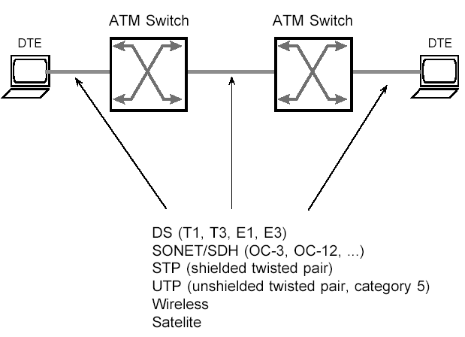
ATM Transmission Media

Slide 17
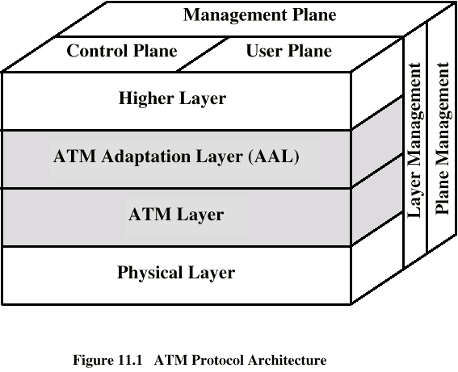
ATM Protocol Architecture
User plane
  Provides for user information transfer
Control plane
  Call and connection control-signaling requests
Management plane
  Plane management
    Manages and coordinates whole system functions
  Layer management
    Resources and parameters in protocol entities (detection of failures and protocol problems)

Slide 18
ATM Layered Model
Three layers are defined:
  PHY (physical layer) -consists of two layers
  Transmission convergence layer- transports information (bits/cells) and does error checking
  Physical medium dependent sub-layer- places ATM cells on cable and does bit timing
  ATM Layer - performs set-up, switching / routing, multiplexing, congestion control, traffic mgt
  AAL (ATM Adaptation Layer) consists of two layers
  Convergence sub-layer -adapting service information to the ATM stream i.e. adds sequencing and control info to aid SAR
  Segmentation and reassembly (SAR) sub-layer- breaks down larger blocks of data into ATM cells and reassembles them at the far end
  Higher layers- supported services, can be video standards e.g. MPEG or IP

Slide 19
ATM Operation
Before data can flow between two nodes on an ATM network a virtual path is set up between the nodes.
  ATM programs the switches with the identification number of the virtual path (VPI) and virtual channel (VCI) before data transfer begins.
  The cell contains only the VPI and VCI and not the entire destination address (the processing is very fast since VPI and VCI are only 28 bits).
Once the VP and VC are created, the path is fixed and all the cells follow this path.

Slide 20
ATM Operation
During path set-up the quality of service (QoS) is also agreed addressing:
  The bandwidth- total information transmitted over a network at a given time
  Transit time(latency)- The delay between the sending of a message by one process and its receipt by another
  Jitter- variation in the time taken to deliver a series of messages
This allows the ATM network to cope with different types of traffic and guarantees the expected quality of connection to the end user.
The most notable feature about ATM is that it is fast due to the following factors
  It discards faulty cells rather than asking for repeats
  It does error checking only on the header.
  The cells have fixed length

Slide 21
Key Components of ATM Networks
ATM cells
ATM switches
ATM virtual connections
ATM service adaptations

Slide 22
ATM Cells
ATM cells are 53 bytes long divided into the following
  Data payload – 48 Octets: contains data payload
  Header – 5 Octets: contains
    Transmission information
    Data identification
    Management information
There are two types of cells
  User Network Interface (UNI)
  Network Network Interface (NNI)

Slide 23
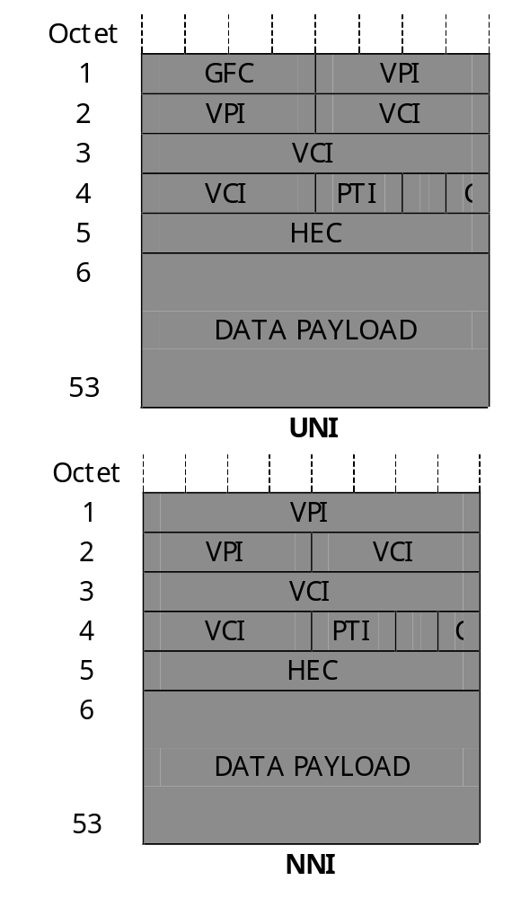
ATM cells
GFC – Generic Flow Control
  Intended for defining a simple multiplexing scheme.
VPI – Virtual Path Identifier
  Used for grouping virtual channels into paths for routing purposes
VCI - Virtual Channel Identifier
  Indicates a particular channel within a virtual path.
PTI - Payload Type
HEC - Header Error Check
C – Cell Loss Priority bit
  Determines the cell's priority in case of congestion

Slide 24
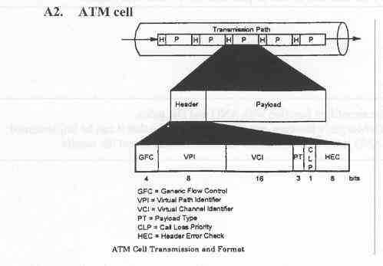
ATM Cells

Slide 25
ATM Switches
ATM switches: multi-ported network devices, which permit the simultaneous operation of multiple links over the same network.
Receive cells at a given input port and, using VPI/VCI field information, switch cells to the appropriate output port.
  VPI/VCI fields are small and hierarchical and therefore the task of forwarding cells is greatly simplified.
  ATM headers are small: Possible to implement the forwarding decision in a silicon state machine.
  These can operate at the wire speed of the output ports (155 Mbit/s or 622 Mbit/s) therefore, the forwarding decision is no longer a bottleneck for network.

Slide 26
ATM Switches
ATM switches contain routing tables, which are filled with VCI/VPI data, gathered from ATM cell headers.
Determination of the route to the end-node is only performed once; thus routing intelligence is not expended on every piece of data in a transfer stream.
ATM switches set up a connection before data transmission.

Slide 27
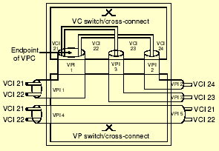
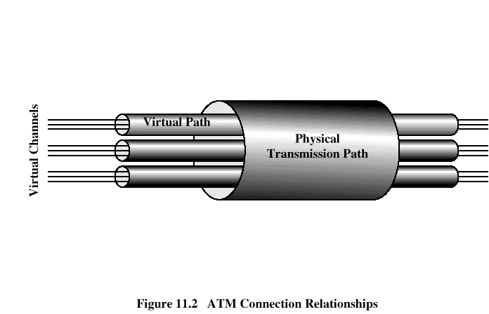
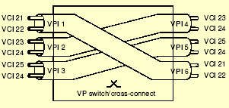
ATM Switching
ATM switching in ATM switches can occur at two levels
  Virtual Path level
  Virtual Channel Level

Slide 28
ATM Virtual Connections
ATM networks operate by establishing virtual connections.
Each virtual connection has a Quality of Service (QoS) metric negotiated prior to the transmission of data which quantifies
  The desired carrying capacity (in Mbit/s or cells/sec) for each service,
  The type of data in the data payload and
  The priority of the data.
Virtual connections reserve network bandwidth for a given transmission task.
There are two types of virtual connections.
  Permanent Virtual Connections (PVC):
  Switched Virtual Connections (SVC):

Slide 29
Service Adaption
When services need to be transported across an ATM network, they need to be adapted into virtual connections.
At the point where a service enters the ATM network it must be segmented into ATM cells in a process known as cell segmentation.
Different types of adaptation are supported depending upon the characteristics of the services.

Slide 30
Bandwidth on demand
On an ATM network, users are able to access any service they require, be it voice, video, data etc.
ATM is able to allocate cells to transport users raw data at a rate determined by the users required services.
This is what is referred to as "bandwidth on demand".

Slide 31
ATM - Advantages vs. Disadvantages
Advantages of ATM
  Flexible bandwidth allocation
  Simple routing due to connection oriented technology
  High bandwidth utilisation due to statistical multiplexing
  Potential QoS (Quality of Service) guarantees
Disadvantages of ATM
  Overhead of cell header (5 bytes per cell)
  Complex mechanisms for achieving QoS
  Congestion may cause cell losses

